Slide 1
2.
Sikkerhed i udviklingsprocesser

Slide 2
Sikker software, hvorfor?
Usikker software
GDPR
Etik
Ansvarlighed
‘Prevention is cheaper than the cure’
NotPetya omkostninger på $1.2B
Phase | Relative cost to correct
Definition | $1
High-level Design | $2
Low-level Design | $5
Code | $10
Unit test | $15
Integration test | $22
System test | $50
Post-delivery | $100

Slide 3
Hvordan bliver software usikkert?
Design fejl
Privelegier
Insecure defaults
Defence in depth
Implementations fejl
Input validering
Fejlhåndtering
Maintainence
Unpatched software
Legacy systemer

Slide 4
Hvordan sikrer man software?
Højere kvalitet = højere sikkerhed
Mindre fejl
Test-Driven Development

Slide 5
Security principles
Minimize attack surface
Establish secure defaults
Principle of least privilege
Principle of defence in depth
Fail securely
Don’t trust services
Separation of duties
Avoid security by obscurity
Keep security simple
Fix security issues correctly

Slide 6
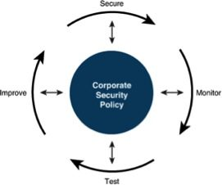
Security is a process - Bruce Schneier
… not a product
Processer og procedurer
Vulnerabilities
Dokumentation

Slide 7
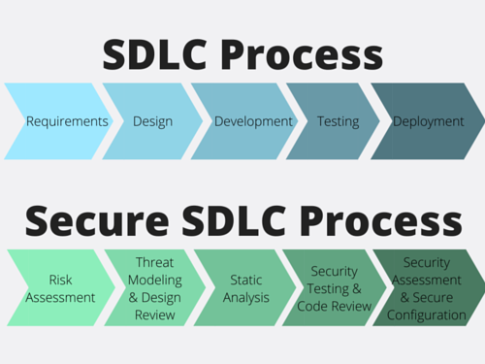
Secure Software Development Lifecycle

